Slide 1
Gippsland Australian Muslim Community Incorporated (GAMCI)
Summary of Years Events
1 July 2015 – 30 June, 2016
Presented at Annual General Meeting
5 November, 2016
Federation University Business Conference Room

Slide 2
July - September
With MUIS organised community Iftar, over Ramadan and Eid Ul Fitr dinner arrangements.
Assisted UMSLV with Eid Festival held in Parkys Traralgon
August visit by Mr Nail Aykan - CEO - Islamic Council of Victoria, by GMS meeting with Latrobe Major, and Victorian Police
Met with MUIS committee about ongoing status of this organisation.
Enquiries begin for GAMCI to be a become a charity.
GAMCI received organizational support grant from VMC

Slide 3
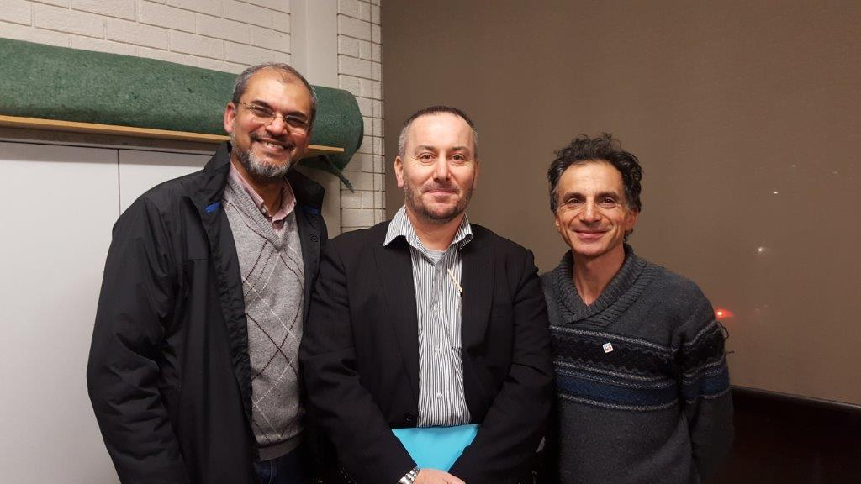
With ICV CEO

Slide 4
September – December
Saturday 10 October GAMCI attended Gippsland – Where We All Belong” festival at Immigration Park Morwell, organised by GMS.
GAMCI participates in November GMS Multicultural Community Meeting, centered around Safety & Wellbeing.
GECC Multicultural Festival talks continue
Volunteer Grants Multicultural and Communities Branch Department of Social Services, GAMCI applies for grants to purchase small equipment items.
Request from ABC Gippsland Radio to participate in online and radio feature as part of ABC series ‘walk a mile in their shoes’ and being a Muslim In Gippsland.
http://www.abc.net.au/news/2015-12-15/being-muslim-in-regional-victoria/7029286
CDAC mentions that up to 50 Syria refugees and families may come to Latrobe Valley area.
Section 32 of Queen Street Hall forward to council for comment.

Slide 5
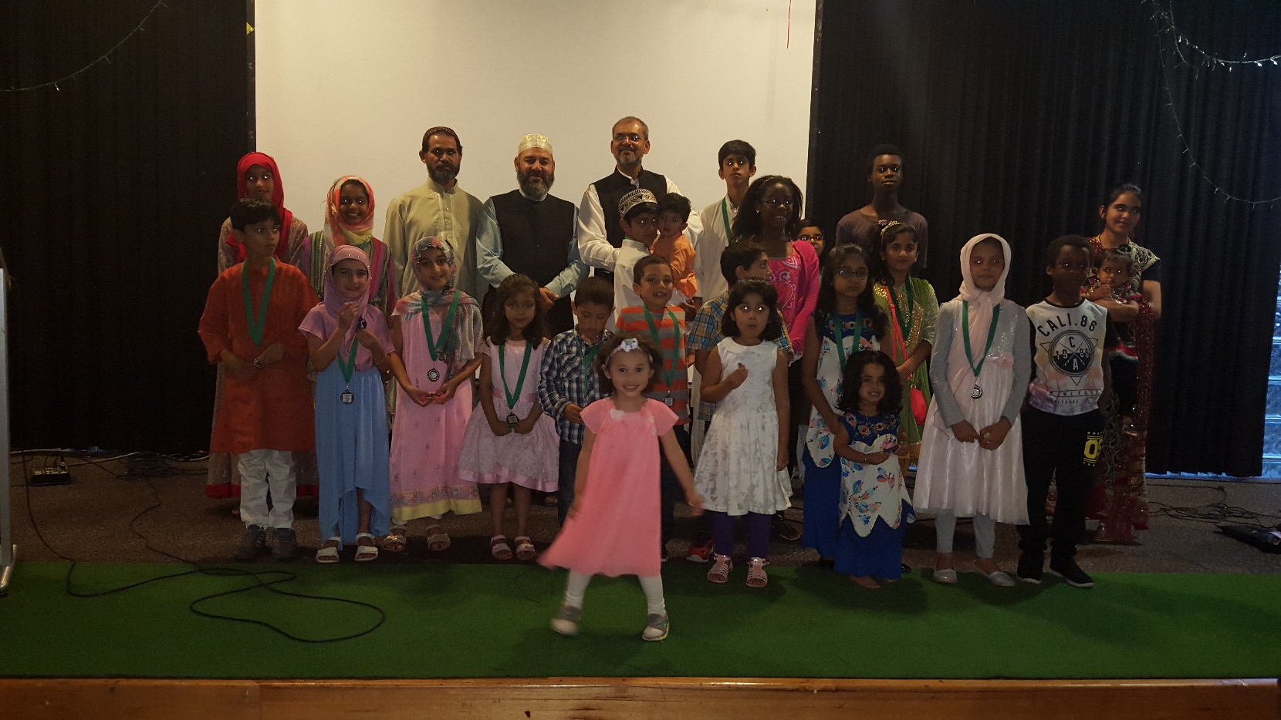
January – February
GAMCI hold third successful function to celebrate the prophet’s (PBUH) birthday (without funding). Involving recitation of Quraan; surahs and performances by children; Islamic quiz; Medals.

Slide 6
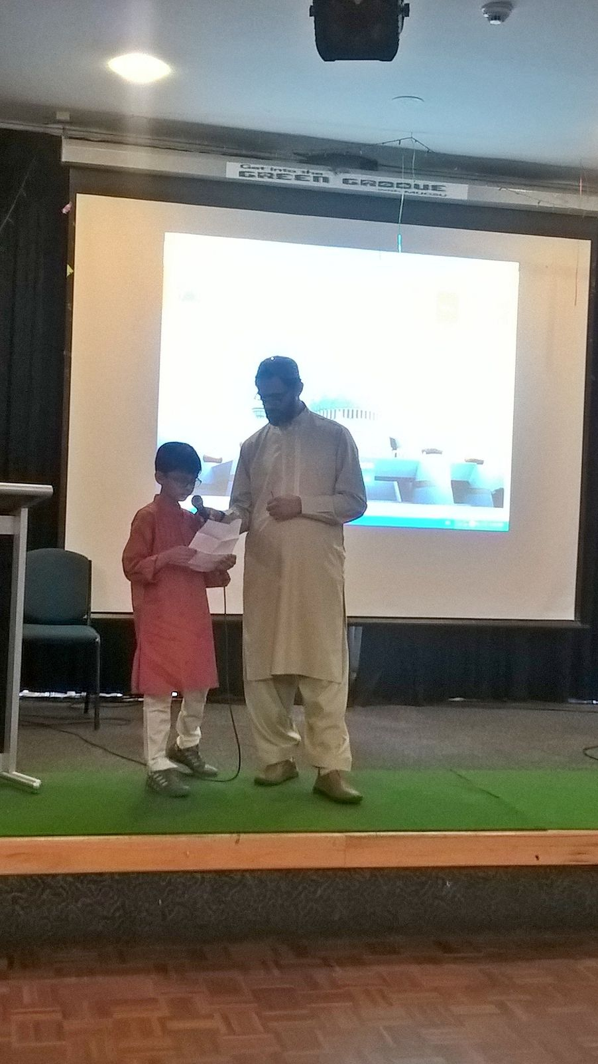
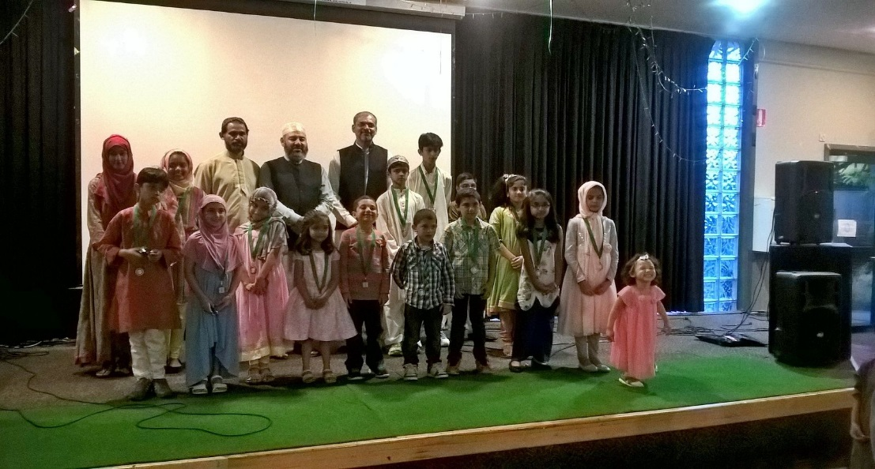

Slide 7
January – February
Discussions continue with Traralgon Cemetery for burial place for Muslims. Dedicated area has been marked. Traralgon cemetery has contacted the Geelong cemetery who provided them with a written procedure which was discussed. GAMCI seeks advice on the formal procedure.
Meeting with ICV to discuss “thanking community event” Sponsored by ICV.
GAMCI provides advice regarding the Nepalese Ghurkha communities wish to erect a Shrine at Immigration Park.
GAMCI assists with the Federation University “Muslim Students Guide”
Dr Anwar Sadat Assistant Secretary resigns, but agrees to update Web site.

Slide 8
March – April
GAMCI holds successful “Thanking the Community Event” with sponsorship from ICV and guest speaker Sherrin Hassan. Budget allowed for children to be catered for away from speeches (this provided great debate). Catering provided in-house.
http://www.latrobevalleyexpress.com.au/story/3796896/plan-for-a-dedicated-place-of-burial/
Cemetery land for Muslims with plans for 50 sites. Planning for Trees was explained. GAMCI attends Inauguration ceremony of the “function room”. GAMCI also attends “Open Day” and also met with a Stone-mason. Procedure was reviewed and validated by UMMA.

Slide 9
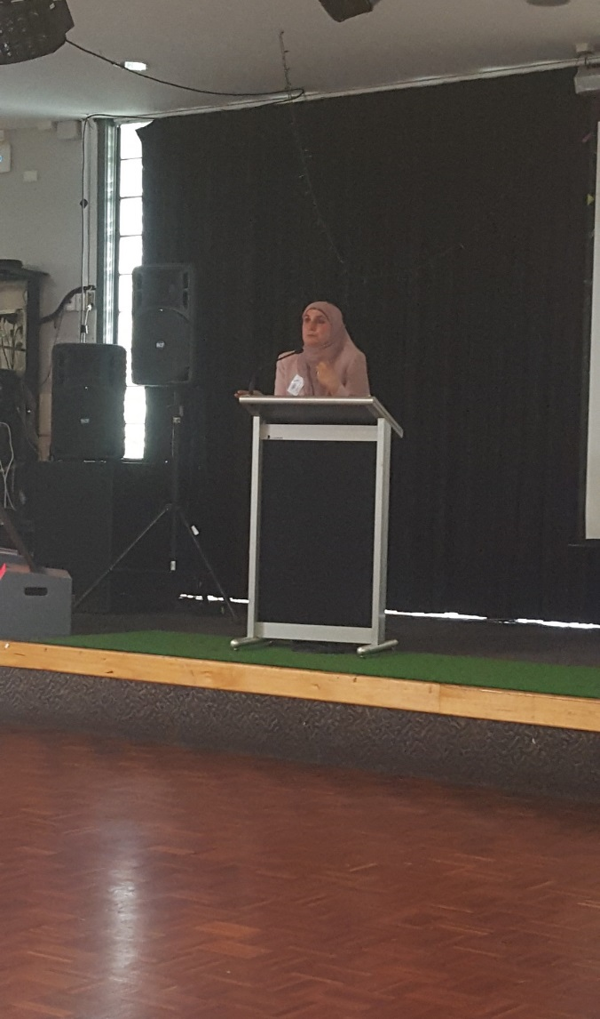
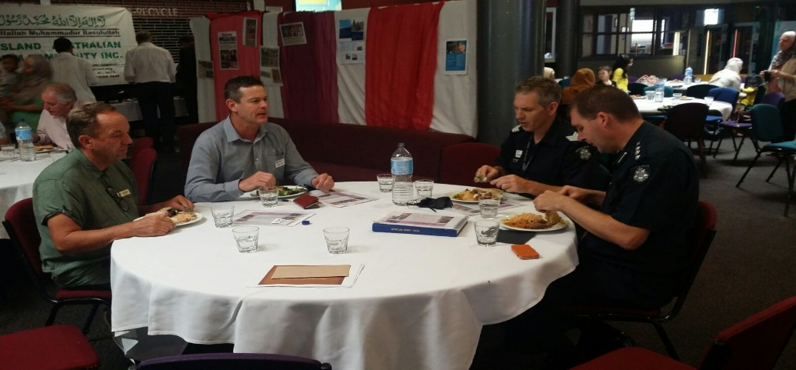
Thanking the Community

Slide 10
Thanking Community Feedback
“This is short note to say thank you on behalf of myself, Acting Inspector Jason Helps and Senior Constable Jessica Lewis for invitation to the GAMCI luncheon on 13 March.
The guest speakers (…….and the food) were extraordinary and have given us an insight into some of the issues and prejudices faced by the Islamic community. Last night I found myself thinking about Sherene Hassan’s comments about separating religion from culture.
We left feeling very privileged and enthusiastic about our new friendships and are looking forward to working together into the future”.
Regards, Ben McWilliams (Sergeant, Morwell Police).

Slide 11
March – April
Council response received from Queens Hall which has a heritage value, and requires multiple planning requirements.
Enquires with Council over Hazelwood North / Church (126 Church Road). Land is on a coal overlay.
GAMCI attended Police Multi-cultural Advisory Committee meeting on March 31. GAMCI briefed the meeting on the peaceful nature of Muslims at the request of the police.
GMS raises issue of united patriot front and Latrobe valley patriot group. GAMCI send email response to members to be vigilant, and report any issues to police.
Tareq Mamun appointed Assistant Secretary.

Slide 12
May – June
GAMCI formally applies for membership status with ICV and accepted. Fee paid and received.
Request to assist “Golden Wattle Mosque”. Members address Friday jummah, and raise over $4,600.
GAMCI enquires about potential Occupancy of “Moe Community Hub” (declined after fee sought).
GAMCI advertises “Interpreting Course” run in Traralgon by Monash University. 10 – 12 people attended, including GAMCI. First time course offered in country Victoria.
GAMCI receives $2,200 Grants from Multicultural and Communities Branch Department of Social Services for purchase of equipment.
Preparations for Ramadan begin, with community Iftars being held on Saturday’s. MUIS committee unable to participate in manner of prior years.
WIN TV cover Iftar celebrations

Slide 13
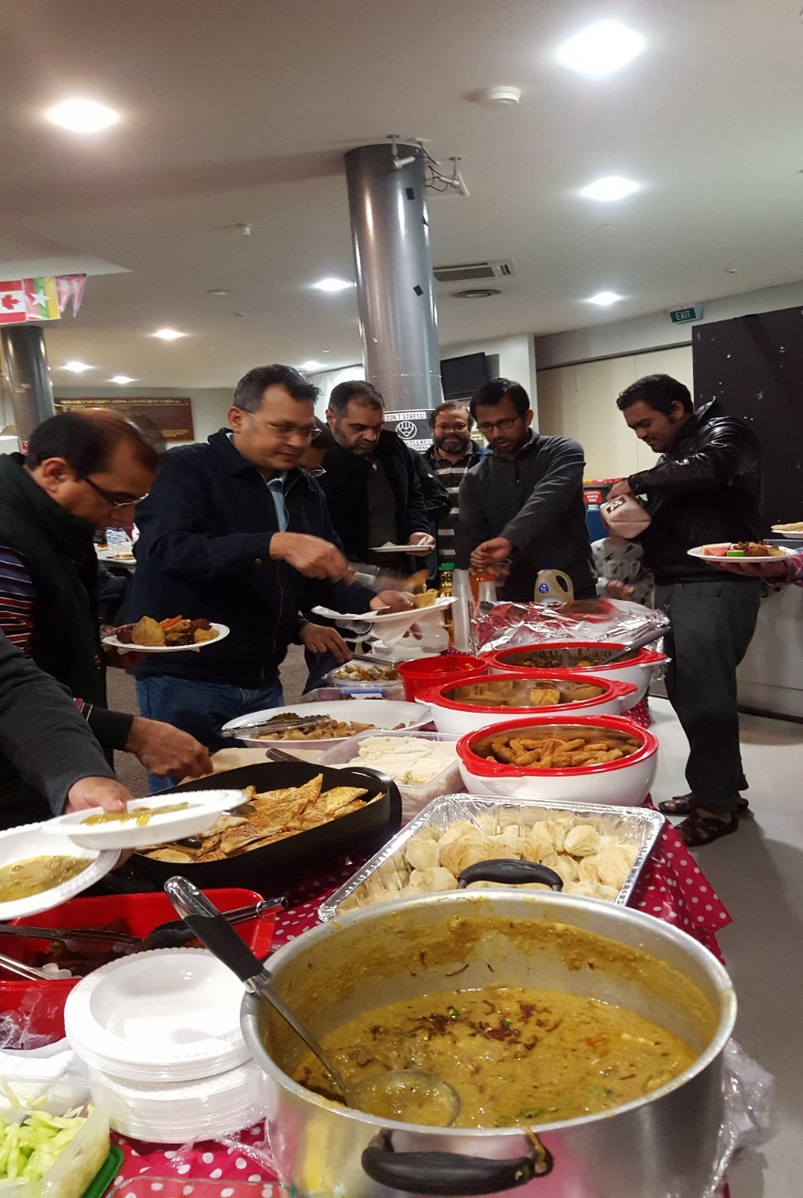

Slide 14
GAMCI Committee

Slide 15
GAMCI Thanks to:
Federation University Staff including Alan Scarlett
MUGSU and MUGSU Staff, including Nigel Beck
MUIS Committee,
UMSLV President and Committee
GECC Committee, and Interfaith Sub-committee including
Dr Kamrul Islam, and Dr Anwar Sadat (web hosting)
ICV
www.gamci.org

